Slide 1

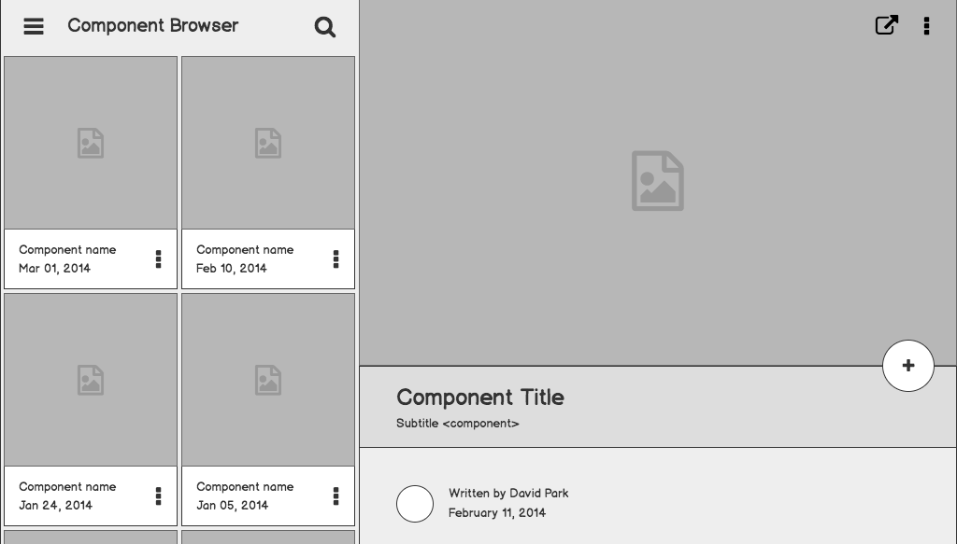

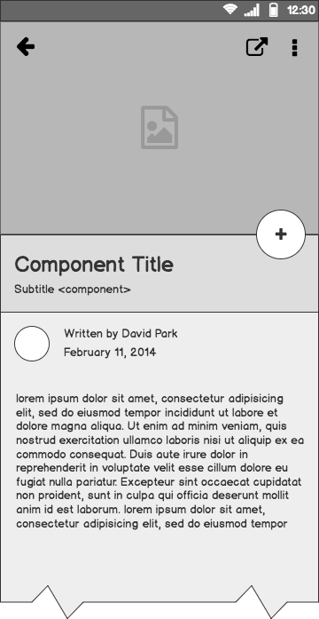
Customer Segmentation using Advanced Clustering Techniques
Hema Sunddar Saaii Srinivas.N Guide By : Aishwarya.S

Slide 2
Problem Statement
Businesses struggle to understand diverse customer behaviors.
Goal: Segment customers into meaningful groups for better marketing strategies.
Approach: Use clustering algorithms to identify hidden patterns in customer data.

Slide 3
Dataset Overview :
Attributes: Age, Gender, Ever_Married, Profession, Work_Experience, Family_Size, Education, Spending_Score, Var_1
Type: Mix of categorical + numerical features
Missing Values: Profession, Work_Experience

Slide 4
Data Preprocessing
Loaded dataset using Pandas (read_csv)
Displayed first 5 rows for initial inspection
Dataset contains categorical & numerical features
Categorical: Gender, Profession, Var_1, Spending_Score
Numerical: Age, Work_Experience, Family_Size
Missing values found in Profession and Work_Experience
Next steps: Handle missing values, encode categorical features, normalize numerical features

Slide 5
Exploratory Data Analysis (EDA)
Checked dataset for missing values
Before handling:
Ever_Married → 50 missing
Graduated → 24 missing
Profession → 38 missing
Work_Experience → 269 missing
Family_Size → 113 missing
Var_1 → 32 missing

Slide 6
Exploratory Data Analysis (EDA)
Imputation Strategy:
Categorical (Profession, Graduated, Ever_Married) → filled with mode
Numerical (Work_Experience, Family_Size) → filled with median
After handling: No missing values remained
Data ready for further EDA (distribution plots, correlations, category counts)

Slide 7
Age Distribution:
Customers spread across wide age groups
Majority fall between 20–40 years
Gender Split:
Balanced distribution of male and female customers
Marital Status:
Significant proportion are ever married vs unmarried
Profession-wise Distribution:
Customers spread across multiple professions
Some professions (e.g., Engineers, Doctors) dominate
Spending Score Distribution:
Categories: Low, Average, High
Most customers in Average spending group
Spending Score vs Age:
Younger customers tend to have High/Low extremes
Older customers show Average spending
Spending Score vs Family Size:
Larger families more often in Average spending
Small families/individuals show High spending

Slide 8
Feature Selection
Identified key attributes influencing customer behavior
Demographic Features: Age, Gender, Family_Size, Ever_Married
Professional Features: Profession, Work_Experience, Education (Graduated)
Behavioral Feature: Spending_Score
Created new dataset X with only selected features
Ensures clustering is based on relevant customer characteristics
Sample of selected feature dataset (after encoding):
Age, Gender, Family_Size, Ever_Married, Profession, Work_Experience, Graduated, Spending_Score

Slide 9
Clustering Techniques
Applied four clustering algorithms for comparison:
K-Means:
Simple, fast, partitions data into k=4 clusters
Hierarchical Clustering:
Builds tree-like structure (dendrogram)
Useful for visualizing nested groups
DBSCAN:
Detects irregular clusters & noise (-1 = outliers)
Gaussian Mixture Model (GMM):
Probabilistic clustering for overlapping groups

Slide 10
Cluster Evaluation
Evaluation Metrics Used:
Silhouette Score – Higher = better cohesion & separation
Davies–Bouldin Index – Lower = better clustering
Calinski–Harabasz Index – Higher = well-defined clusters

Slide 11
Results
K-Means: Best overall → Silhouette = 0.3054, CH Index = 1724.20
Hierarchical: Moderate performance → Silhouette = 0.2764
DBSCAN: Weak → Low CH Index (19.10) and high DB Index (2.07)
GMM: Acceptable but lower than K-Means (Silhouette = 0.2536)

Slide 12
Comparison with Var_1 (predefined categories):
Used Adjusted Rand Index (ARI) → measures alignment with true categories
Confusion matrices show K-Means & Hierarchical align better with Var_1
DBSCAN performs poorly due to noise labeling
Key Insight:
K-Means clustering gave the most meaningful and consistent results

Slide 13
Business Strategies for Each Group
Identified Customer Segments (K-Means Clusters):
Cluster 0 – Middle-aged Graduates, Stable Families
Age ~44, mostly married, family size ~2.5
Strategy: Family-oriented offers, insurance, savings products
Cluster 1 – Experienced Executives (Older Professionals)
Age ~65, highly professional background, smaller families
Strategy: Premium services, retirement plans, exclusive loyalty programs

Slide 14
Business Strategies for Each Group
Cluster 2 – Young Professionals (Unmarried, Large Families)
Age ~27, low graduation rate, bigger family size ~3.6
Strategy: Budget-friendly offers, career-oriented financial products, digital campaigns
Cluster 3 – Mid-career Employees
Age ~44, mixed education, moderate family size ~2.8
Strategy: Upselling opportunities, lifestyle benefits, targeted marketing

Slide 15
Conclusion
Successfully applied advanced clustering techniques to segment customers.
Identified distinct customer groups based on demographic, professional, and behavioral attributes.
K-Means clustering provided the most meaningful and well-defined segments.
Cluster insights enabled targeted business strategies for improved customer engagement and profitability.
Future scope:
Apply real-time clustering for dynamic customer segmentation.
Use deep learning models to enhance segmentation accuracy.

